Slide 1

Spooky Author Identification
By: Ponaroth Eab, Julie Kasparian, Fernando Mejia, Daniel Preciado, and Margarita Nuridjanian
Notes:
Fernando

Slide 2
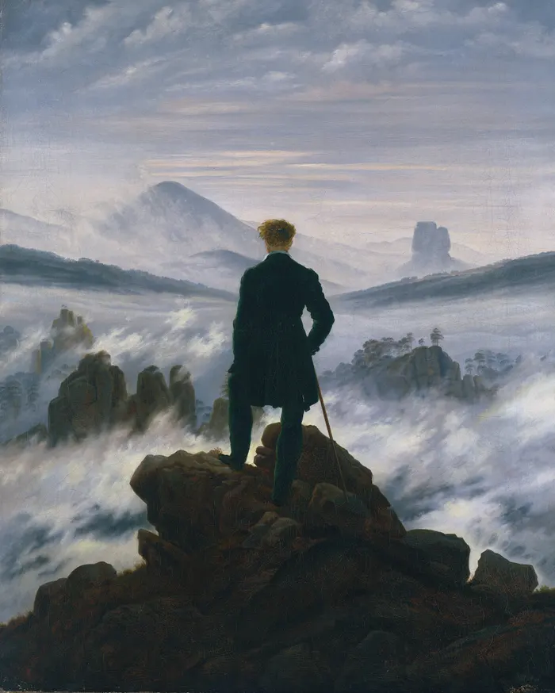
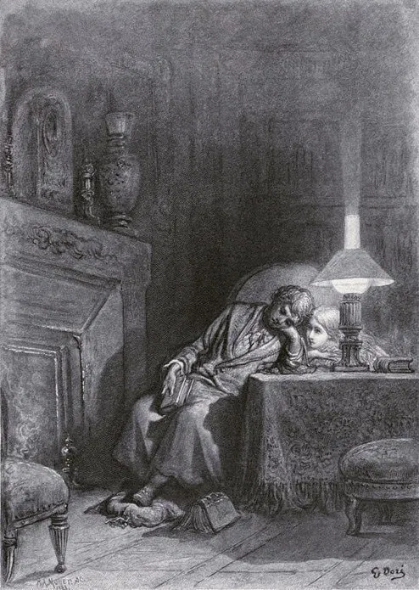
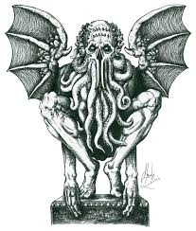
Classification
Mary Shelley
Edgar Allan Poe
H.P. Lovecraft
Fernando
Notes:
Fernando

Slide 3
Description, Details, Goals
Description: You're challenged to predict the author of excerpts from horror stories by Edgar Allan Poe (EAP), Mary Wollstonecraft Shelley (MWS), and H.P. Lovecraft (HP).
Details: We are given checks of the writings of three horror authors and are tasked to identify each based on an excerpt of their work.
Goals: We will each use a different model in order to identify the author and will then compare the accuracy of the models and why think it might be the case.
Fernando
Notes:
Fernando

Slide 4
Details of Data
The competition dataset contains text from works of fiction written by spooky authors of the public domain: Edgar Allan Poe, H.P. Lovecraft and Mary Shelley.
The data was prepared by chunking larger texts into sentences using CoreNLP's MaxEnt sentence tokenizer, so you may notice the odd non-sentence here and there. Your objective is to accurately identify the author of the sentences in the test set.
EAP = 7900, MWS = 6044, HPL = 5635.
Fernando
Notes:
Fernando

Slide 5
Data Methods and Algorithms
Algorithms: Each text snippet is a vector, with each word corresponding to a dimension. The goal of the project is to get similar comments closer together in a high dimensional vector space.
Methods:
KNN
Logistic Regression
Decision Tree
Linear Regression
B.E.R.T.
Daniel
Notes:
Fernando

Slide 6
KNN
KNN with K= 5
Accuracy scores:
Filtering out stop words = 0.4002
Without filtering stop words = 0.4651
Without filtering stop words and removing HPL= 0.635
Daniel

Slide 7
Logistic Regression
We notice that Logistic Regression has a high level of accuracy. If we filter the dataset for only authors EAP and MWS, as well as take out the stop word from CountVectorize() command we get an increase in accuracy.
Accuracy scores:
Without filtering stop words = 0.79
No stop words = 0.82
No stop words and with filter = 0.86
Ponaroth Eab

Slide 8
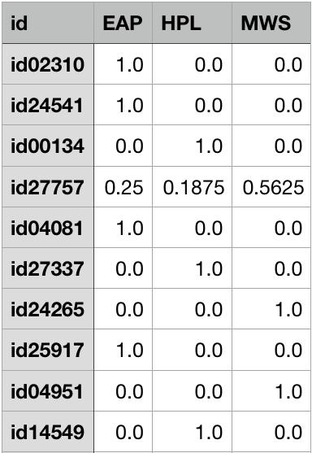
Decision Tree
This model does not work quite well because it has overfitting problem.
Accuracy scores:
Without filtering stop words = 0.59
No stop words = 0.53
No stop words and filter = 0.69
Ponaroth Eab

Slide 9
Linear Regression
Linear regression gets an RMSE of 3.625, which is not great for a data set that only have only three different labels.
Cross-validation method scores a 1.501 on RMSE, which is more than two-time better.
This is a classification problem not regression.
Linear regression needs more relevant numerical labels for it to predict better.
Ponaroth Eab

Slide 10
Naive Bayes
The best classifier for this problem with 89% accuracy.
Great for problem where every feature are equally important.
Comparing word occurrence against the the label to get the probability.
Training:
bats/EAP = 30/102 = 0.30
bats/MWS = 40/90 = 0.42
bats/HPL = 70/100 = 0.70
Test:
bats --> HPL
Ponaroth Eab

Slide 11
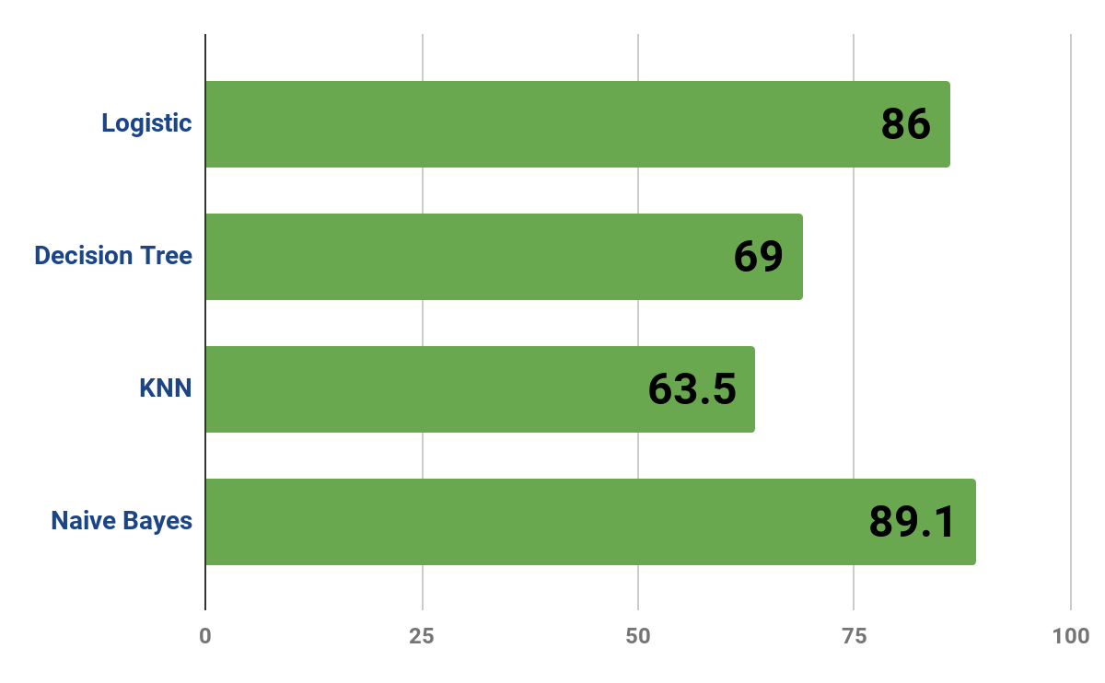
Visualization of final Results
Ponaroth Eab

Slide 12
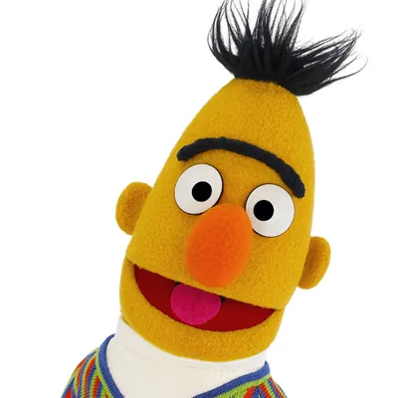
B.E.R.T.
Machine Learning- focuses on teaching computers how to learn without the need to be programmed for specific tasks.
NLP(Natural Language Programming)- machine learning with the ability of a computer to understand, analyze, manipulate, and potentially generate Language.
Pre-Trained- a model that was trained on a large benchmark dataset to solve a problem similar to the one that we want to solve.
Fernando

Slide 13


B.E.R.T. Results
My GPU was too old in order to do the computations needed for BERT .
Solutions :
Buy a better graphics card (Nvidia has great support for machine learning.)
Cloud Computing(Google Collab)

Slide 14
Thank you!

